Slide 1

Decorator
Design Pattern Presentation
Jack Ambery
17 Feb 2021

Slide 2
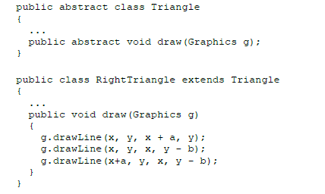
Example of a Decorator
Say we have a Triangle class which is the parent class to RightTriangle and IsocelesTriangle. We want to make a variant of these that have a median line drawn with them.
Notes:
Start with example that way it will be easier to imagine one before definition is given.

Slide 3
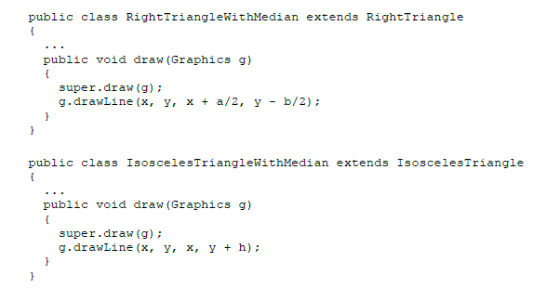
What we could do:
We could create a class for every kind of Triangle and their modified versions
But this is annoying, repetitive, and can get out of control and very confusing
Polymorphism will not allow you to show the same object in different ways (with/without the median line in our case)

Slide 4
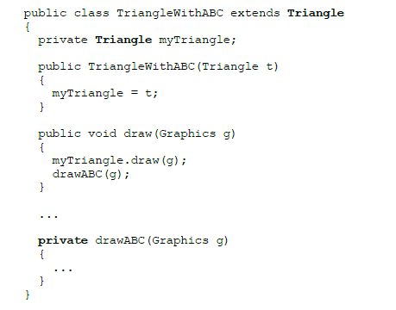
We should use a decorator!
A decorator design works as a wrapper class
TriangleWithABC HAS A Triangle relationship
It is a way to give an object/class certain methods or attributes
In our case, we can instead make a TriangleWithABC which has a private method to draw our median line
Notice:
A decorator both extends the base class and has a field of the base type class

Slide 5
Why a Decorator?
A decorator can help solve these two problems:
The lack of multiple inheritance for the same functionality to classes on diverging inheritance branches
The difficulty of changing or extending the behavior of an individual object at run time
A decorator adds a behavior or feature to the “decorated” class
The decorator’s constructor initializes the embedded field to an object to be decorated

Slide 6
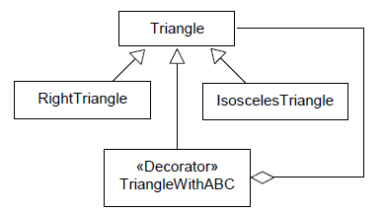

UML Diagram

Slide 7


What can we do with a decorator?
We can now create different triangles and choose whether we want them to be “decorated” or not
We can also pass a decorated Triangle through another decorator since our decorated Triangle
is still a Triangle
Note: the exact same would work if the base type were an interface, rather than class (if Triangle was an interface)

Slide 8
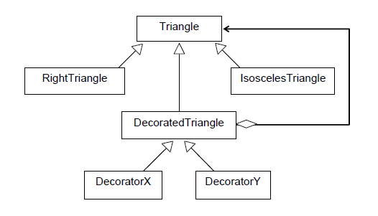
Decorator Adapter
You could also create a generic decorator or “decorator adapter”
All other decorators would be derived from this decorator adapter

Slide 9
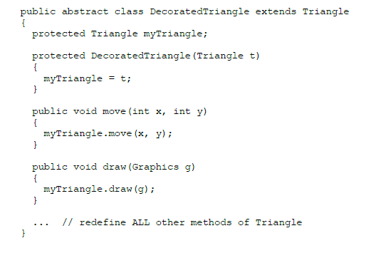
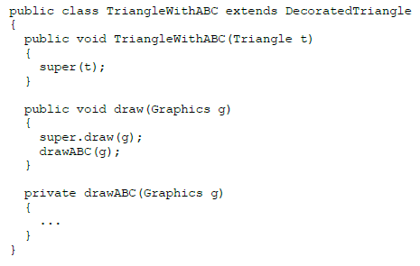

Slide 10

Potential Bugs to watch out for
An object of a decorator class possesses the same fields as the decorated object, but they are not used and remain uninitialized (because the wrapper class extends the wrapped class)
This will become an issue when a decorated object is
passed to a method that accepts an undecorated object
and refers to its fields directly
To avoid this, you should not refer directly to fields of other
objects passed to methods, even if they appear to be objects
of the same class
Also, too many decorated layers make code unreadable

Slide 11

Review Questions!
When is it a good idea utilize a decorator?
Explain the relationship between the decorator and the base class.
What is one of the problems a decorator can resolve?
What is a “decorator adapter”?
When would it be a good idea to use one?

Slide 12
Further Reading:
More basic article further explaining the benefits of a decorator, uses a backpack concept to explain:
https://medium.com/@andreaspoyias/design-patterns-a-quick-guide-to-decorator-pattern-2159b97863f
Research article about someone’s use of a decorator and what they found (Great UML Diagrams):
https://www.researchgate.net/publication/308118364_A_Design_Pattern_Approach_to_Improve_the_Structure_and_Implementation_of_the_Decorator_Design_Pattern
Article that is a bit lengthy but uses Amazon’s checkout page to create a more real-world decorator implementation:
https://www.automatetheplanet.com/decorator-design-pattern/

